Slide 1
Software System Architectures (NSWI130) Architectural Views
Martin Nečaský, Ph.D.
Department of Software Engineering
Faculty of Mathematics and Physics
Charles University in Prague

Slide 2
IEEE 1471 Conceptual Framework
Mission
fulfills
1..*
Environment
influences
System
has
Architecture
inhabits
has interests in
has
1..*
described by
identifies
Stakeholder
Architectural Description
1..*
is important to
1..*
is addressed to
1..*
has
1..*
selects
1..*
identifies
1..*
organized into
1..*
conforms to
Concern
Viewpoint
View
used to cover
aggregates
1..*
consists of
1..*
1..*
Library viewpoint
establihes methods for
Model
1..*

Slide 3
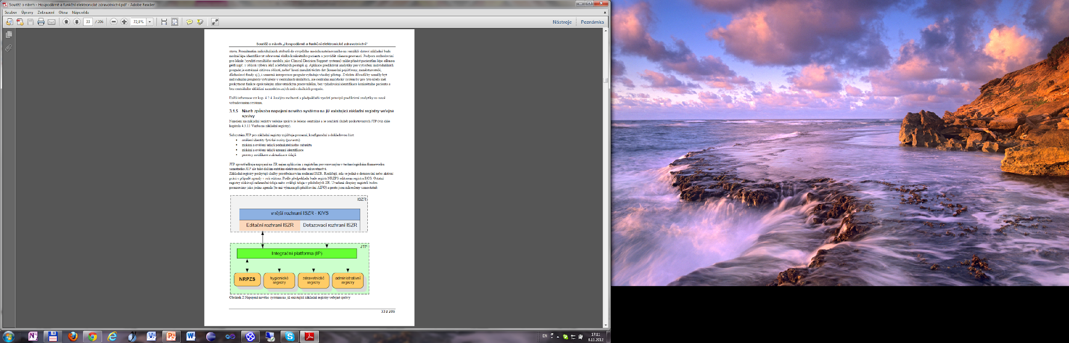
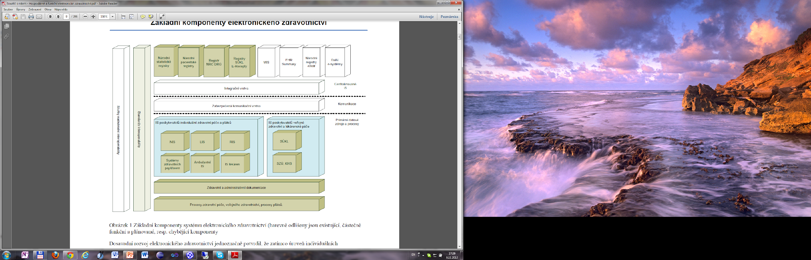
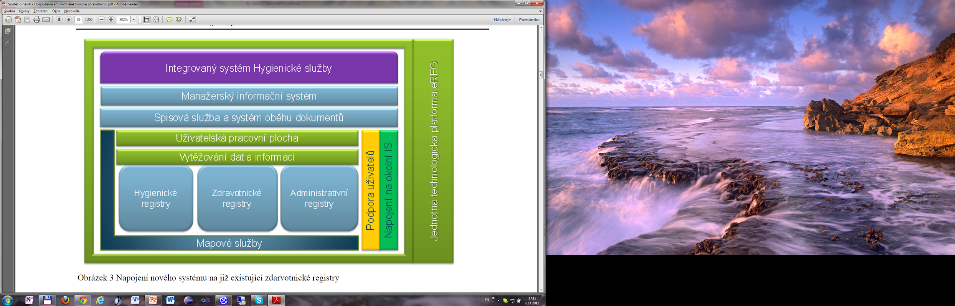
Notes:
Základní komponenty systému elektronického zdravotnictví (barevně odlišeny jsou existující, částečně funkční a plánované, resp. chybějící komponenty
Napojení nového systému na již existující základní registry veřejné správy
Napojení nového systému na již existující zdarvotnické registry

Slide 4
Architectural Views
different approaches (models) in the literature
Bass & Clemens & Kazman
Kruchten’s 4+1 view
Rozanski & Woods
C4 model
this lecture is about principles of architectural views
not about their graphical notations and documentation
may have standardized graphical notation

Slide 5
(Bass, Clemens, Kazman)’s Architectural Views

Slide 6
(Bass, Clemens, Kazman)’s Architectural Views
module viewpoint
system structured into code units
component-and-connector viewpoint
system structured into elements with runtime behavior
allocation viewpoint
relationship of the system to non-software structures

Slide 7
Module Viewpoint Definition
static implementation units of the system and their
code-based way of considering a system
elements = modules
implementation unit that provides a coherent set of responsibilities
has properties
name, ...
relationships = static relationships between modules
part of, depends on (uses) and is a

Slide 8
Why Module Viewpoint
What is the functional responsibility of a module?
What other modules a module uses?
What modules are related to a module by part-of or generalization relationships?

Slide 9
Why Module Viewpoint
Shows decomposition of code into units.
Determines assumptions each unit can make about other units.
Helps with project planning and work assignments.

Slide 10
Why Module Viewpoint
Helps to plan incremental development.
Improves software reuse.

Slide 11
Why Module Viewpoint
Allows for change-impact analysis.
Allows for requirements traceability analysis.

Slide 12
Why Module Viewpoint
Helps to communicate the functionality of a system and the structure of the code.

Slide 13
Module Properties
Name
Visibility
Functional responsibilities
Implementation details
mapping to source code, testing information, management information, restrictions
Revision history

Slide 14
Specific Kinds of Module Viewpoint
Module viewpoint
Decomposition viewpoint
Usage viewpoint
Class viewpoint
Notes:
! Data viewpoint = Information Model viewpoint in the other classification at the end of these slides.

Slide 15
Decomposition Viewpoint
modules are logically decomposed to smaller ones until they are small enough
modules related by “is a sub-module of” relationship

Slide 16
Module in Decomposition Viewpoint
represents a common starting point for the design
has associated various products
has its interface and secrets (information hiding)

Slide 17
Why Decomposition Viewpoint
to divide and conquer
to support system’s modifiability
to support project managers

Slide 18
National Open Data Catalog

Slide 19
National Open Data Catalog
Presentation
Domain
Data Sources

Slide 20
National Open Data Catalog
Presentation
Domain
Data Sources
Services
Model

Slide 21
National Open Data Catalog
Presentation
Domain
Data Sources
Services
Model
Dataset
Distribution

Slide 22
National Open Data Catalog
Presentation
Domain
Data Sources
Services
Search Datasets
Get Dataset Detail
Model
Dataset
Distribution

Slide 23
National Open Data Catalog
Presentation
Domain
Data Sources
Services
Dataset Source
Search Datasets
Get Dataset Detail
Model
Dataset
Distribution

Slide 24
National Open Data Catalog
Presentation
Domain
Data Sources
Services
Dataset Source
Search Datasets
Dataset Index
Get Dataset Detail
Dataset Gateway
Model
Dataset
Distribution

Slide 25
National Open Data Catalog
Presentation
Domain
Data Sources
Web application
Services
Dataset Source
Search Datasets
Dataset Index
Get Dataset Detail
Dataset Gateway
Public API
Model
Dataset
Distribution

Slide 26
National Open Data Catalog
Presentation
Domain
Data Sources
Web application
Services
Dataset Source
Search Datasets
Dataset Index
Get Dataset Detail
Dataset Gateway
Public API
Model
Dataset List
Dataset
Dataset Detail
Distribution

Slide 27
National Open Data Catalog
Presentation
Domain
Data Sources
Web application
Services
Dataset Source
Search Datasets
Dataset Index
Get Dataset Detail
Dataset Gateway
Public API
Model
Dataset List
Dataset
Dataset Detail
Distribution

Slide 28
Modules and Source Code
class DatasetIndex {
public List<DatasetValueObject> find(String namePattern, ...) {
…
}
…
}
Dataset Source
Dataset Index
Dataset Gateway

Slide 29
Modules and Source Code
class DatasetIndex {
public List<DatasetValueObject> find(String pattern) {
…
}
…
}
class DatasetGateway {
public static DatasetValueObject load (IRI dsIRI) {
…
}
public static void insert (DatasetValueObject ds) {
…
}
…
}
Dataset Source
Dataset Index
Dataset Gateway
class DatasetValueObject {
private String name ;
private List<DistributionValueObject> distributions ;
public String getName() { … }
…
}
class DistributionValueObject {
private String name ;
private IRI downloadURL ;
public String getName() { … }
…
}

Slide 30
Modules and Source Code
Public API
const app = express();
…
app.get('/dataset-list', function (req, res) {
…
}
app.get('/dataset-detail', function (req, res) {
…
}
Dataset List
Dataset Detail

Slide 31
Modules and Source Code
class DatasetIndex {
public List<DatasetValueObject> find(String pattern) {
…
}
…
}
implementation
class DatasetIndexTest extends UnitTest {
public void runTestingScenarios () {
…
}
…
}
Dataset Source
unit test
Dataset Index
Dataset Gateway
interface
class Index {
public List<Findable> find(String pattern);
…
}

Slide 32
Usage Viewpoint
how modules use other modules
“A module uses another if the correctness of the first requires the presence of a correct version of the other.”

Slide 33
Why Usage Viewpoint
development planning
team allocation
system extensibility and modifiability
software reuse

Slide 34
uses
National Open Data Catalog
Presentation
Domain
Data Sources

Slide 35
uses
Web application
Dataset Source
Dataset Index
Public API
Services
Dataset List
Search Datasets
Dataset Gateway
Dataset Detail
Get Dataset Detail
Model
Distribution
Dataset

Slide 36
uses
Web application
Dataset Source
Dataset Index
Public API
Services
Dataset List
Search Datasets
Dataset Gateway
Dataset Detail
Get Dataset Detail
Model
Distribution
Dataset

Slide 37
Usage Viewpoint
in addition to “uses” we can also consider “is-allowed-to-use”, “depends” and “calls”
calls : A is required to call B but A does not necessarily further depend on what B does
uses : B produces its result (either when called by A or independently of being called by A) and A uses the result
is-allowed-to-use : B produces its result (either when called by A or independently of being called by A) and A may use the result
depends on : A may run only when B performs its functionality independently of being called by A but it does not necessarily use the result of B

Slide 38
Class Viewpoint
Are there any similarities in behavior or capabilities of modules which can be captured by sub-classing?
"is-a" relationship
allows us to reason about re-use and incremental addition of functionality
Notes:
Discuss also that modules can inherit rules for developers.

Slide 39
uses
Services
Get Dataset Detail
Public API
Dataset Source
Dataset Detail
Get Related Datasets
Dataset Index
Model
Dataset

Slide 40
uses
is-a
Services
Get Dataset Detail
Public API
Get Related Datacubes
Dataset Detail
Get Related Datasets
Get Related Taxonomies
Model
Dataset Source
Dataset
Dataset Index

Slide 41
The End Check out https://www.ksi.mff.cuni.cz/ for amazing student project topics and bachelor’s, master’s and doctoral theses.

